Slide 1
Enhancing System Security by Integrating Zephyr Bootloader and MCU Boot
Afzal Hasan
Associate Staff Engineer
Samsung Semiconductor India Research
Priya Dixit
Staff Engineer
Samsung Semiconductor India Research

Slide 2
Agenda
Importance of system security in Zephyr bootloader
System architecture of Zephyr RTOS
Integration process of Zephyr bootloader and MCU Boot
Secure Boot process of proposed bootloader
Firmware Upgrade process of proposed bootloader
Rollback protection and bootloader recovery
Threat models
Limitations and Challenges
Future Development

Slide 3
Introduction
Enhancing system security in an interconnected and digital world requires the integration of robust security measures
The Zephyr bootloader is a lightweight and secure mechanism that enables trusted booting and firmware updates on resource-constrained devices, ensuring software integrity and preventing unauthorized code execution.
The MCU boot complements the Zephyr bootloader by providing an additional layer of security through secure firmware updates and cryptographic authentication, preventing unauthorized or compromised firmware from compromising the system.
Enabling control over executed firmware to prevent security breaches, unauthorized access, and malicious activities.
Enhancing system security by establishing a trusted environment, protecting sensitive data, preserving system integrity, and maintaining user trust in the face of evolving threats.
Discussion about Zephyr RTOS System Architecture.

Slide 4
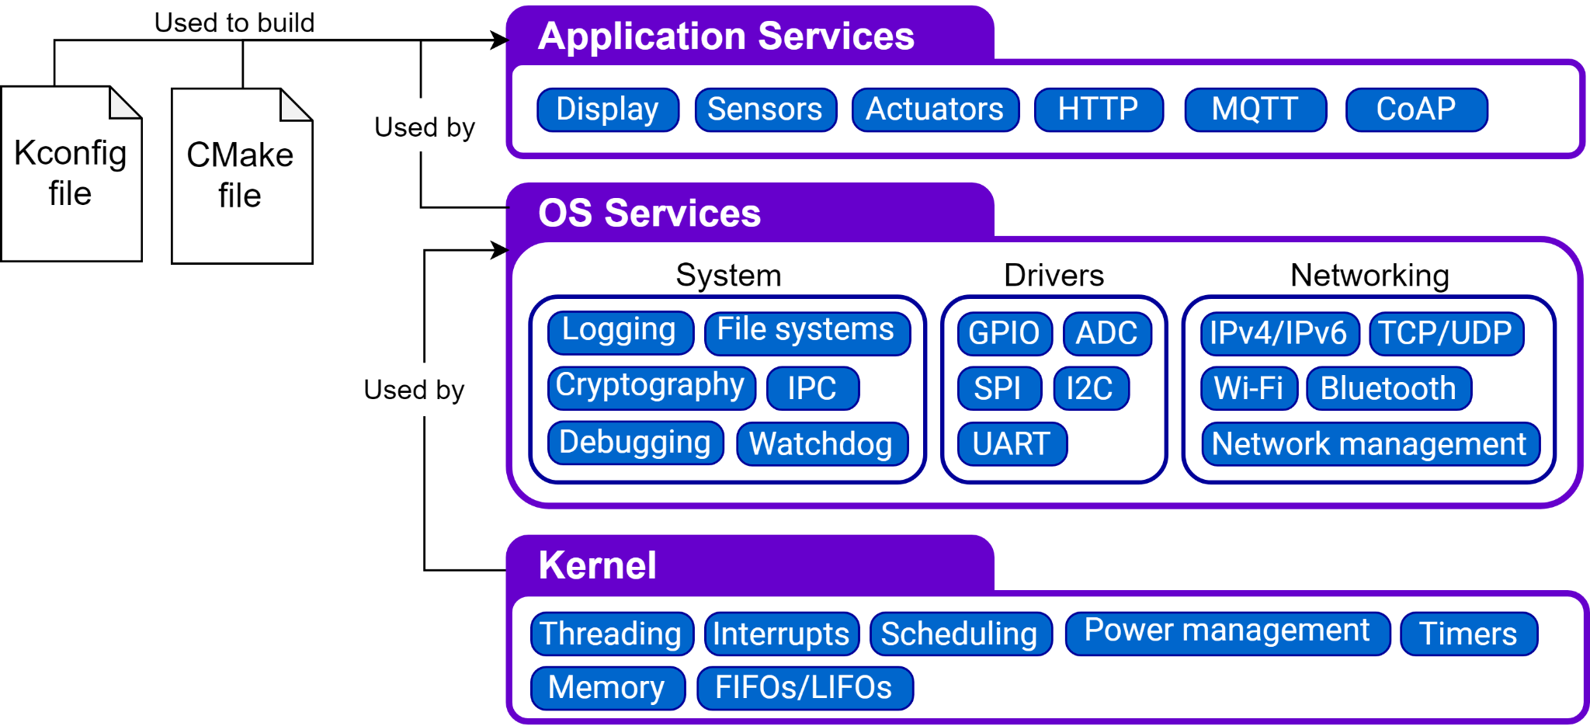
System Architecture
Image Reference: Documentation — Zephyr Project Documentation

Slide 5
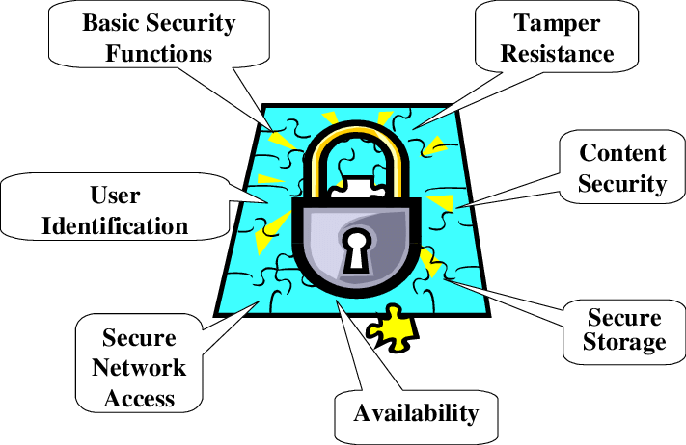
Importance of System Security
Measures and Practices implemented to protect the integrity, confidentiality, and availability of the software, hardware and data within the embedded system.
Key Considerations for System Security in Embedded Systems:
Secure Boot
Firmware Security
Communication Security
Access Control and Memory Protection
Security Updates
Physical Security
Supply Chain Security
Security testing and vulnerability
Compliance and Standards
Image Reference: Lancope Enhances Network Visibility and Security Analytics in StealthWatch System 6.6 - Network Virtualization

Slide 6
Concept of Integrating Zephyr Bootloader and MCU Boot
Combination of both bootloaders provides a robust and secure firmware update solution for MCU based devices using the Zephyr RTOS.
By leveraging MCU Boot’s flexibility and security features, developers can ensure reliable and authenticated firmware updates.
The integration simplifies the development process by providing a unified framework for managing firmware updates within the Zephyr RTOS environment.
Next, we will discuss about Zephyr Bootloader, MCU Boot and their integration process.

Slide 7
Zephyr Bootloader Features
Lightweight Design
Secure Booting
Firmware Update Support
Cryptographic Verification
Flexible Configuration
Error Handling and Recovery
Compatibility
Integration with Zephyr RTOS

Slide 8
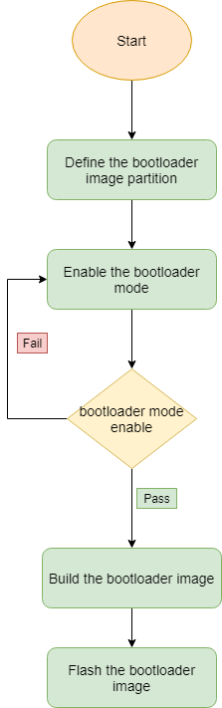
Zephyr Bootloader

Slide 9
MCU Boot Features
Secure Boot Process
Firmware Update Support
Cryptographic Verification
Flexible Configuration
Error Handling and Recovery
Tamper Resistance
Compatibility
Integration Possibilities

Slide 10
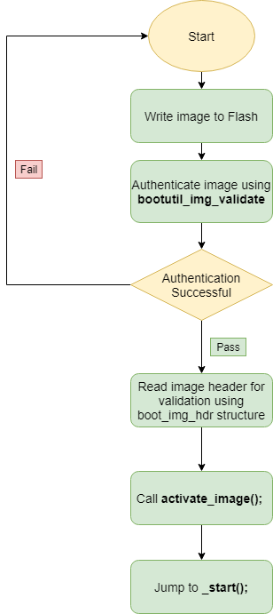
MCU Boot sequence

Slide 11

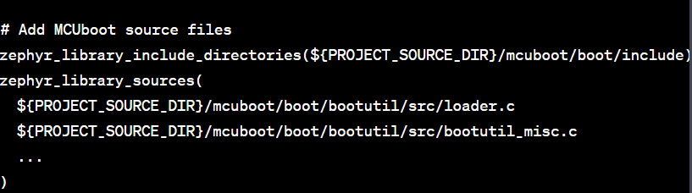
Integration Process of Zephyr Bootloader and MCU Boot
Understand Zephyr RTOS and MCUboot
Set up the Development Environment
Select the target hardware
Integrate MCUboot into Zephyr Bootloader
Add MCUboot as a submodule to Zephyr project
Modify Zephyr project ‘CMakeLists.txt’ to include MCUboot

Slide 12
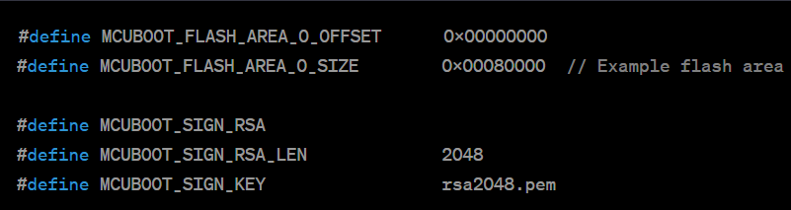


Integration Process of Zephyr Bootloader and MCU Boot
Configure Zephyr RTOS for the target hardware
Customise MCUboot configuration
Implement Board Support Package (BSP)
Test and Debug

Slide 13
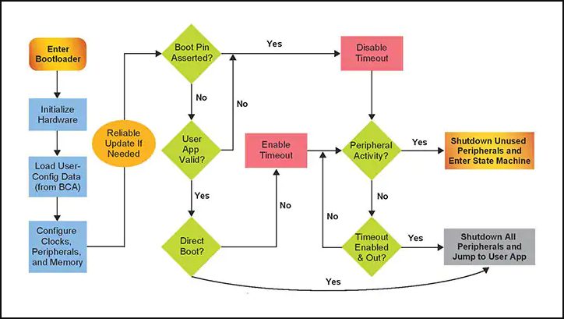
Bootloader Flowchart
Image Reference: MCU Bootloader | NXP Semiconductors

Slide 14
Benefits of Integrating Zephyr Bootloader and MCU Boot
Enhanced System Security
Secure Booting
Firmware Updates
Cryptographic Verification
Tamper Resistance
Protection against Unauthorized Code Execution
Mitigation of Firmware-Level Attacks
Maintaining User Trust

Slide 15
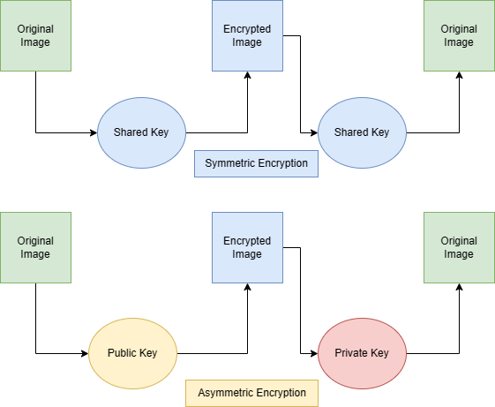
Secure Boot
Secure Boot ensures the authenticity and integrity of a system boot sequence using PKI
For secure boot, the digital signature is created using a private key and is verified using the corresponding public key.
Using cryptographic keys and digital signatures, we a chain of trust is established for secure booting.
Secure Boot ensures only trusted hardware with authorized and trusted software components are loaded during the boot process
Notes:
Secure Boot Process
The secure boot process, implemented through Public Key Infrastructure (PKI), is a critical component in ensuring the integrity and authenticity of a computer's boot sequence. During the secure boot process, a computer's firmware verifies the integrity and authenticity of each component involved in the boot process, starting from the firmware itself, through the bootloader, and up to the operating system. PKI plays a vital role in this process by utilizing asymmetric cryptography.
At the core of PKI is the concept of a public-private key pair. The firmware, as the trusted entity responsible for initiating the boot process, possesses a private key known only to itself. This private key is used to sign cryptographic hashes of the firmware and bootloader, generating digital signatures. These digital signatures are then securely stored in a Trusted Platform Module (TPM) or a similar secure hardware component.
As the boot process progresses, the firmware verifies the digital signatures of the components it loads against the corresponding public keys stored within its firmware. These public keys are typically pre-installed and trusted by the manufacturer. If the digital signatures are valid, indicating that the components have not been tampered with or maliciously modified, the boot process continues. However, if the signatures do not match or are missing, the firmware halts the boot process, preventing the system from loading potentially compromised software.
The use of PKI in the secure boot process ensures that only trusted and verified components are executed, mitigating the risk of unauthorized or malicious software compromising the system. It establishes a chain of trust, with the private key held securely by the firmware and the public keys distributed by the manufacturer. This combination of asymmetric cryptography and trusted hardware safeguards the boot process and forms a foundation for establishing a secure computing environment.

Slide 16
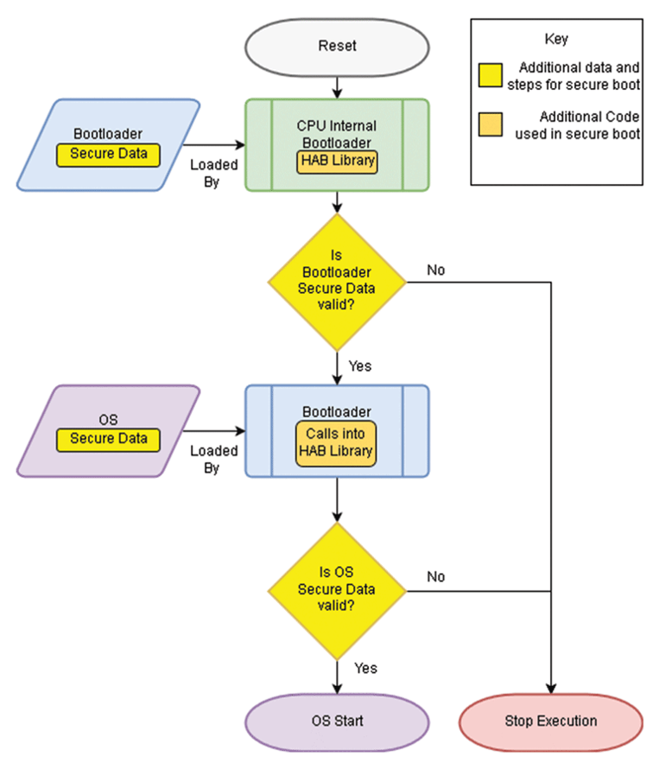
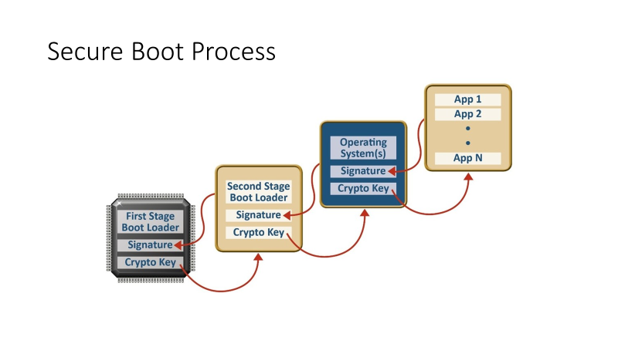
Secure Boot process
Image Reference: https://www.keyfactor.com/blog/what-is-secure-boot-its-where-iot-security-starts/
https://ealtili.medium.com/secure-boot-process-8b5fa87903f4

Slide 17
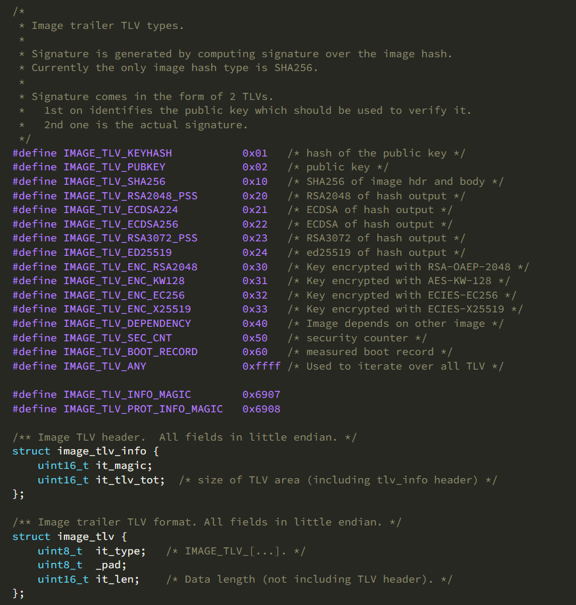
MCUboot secure Image example

Slide 18
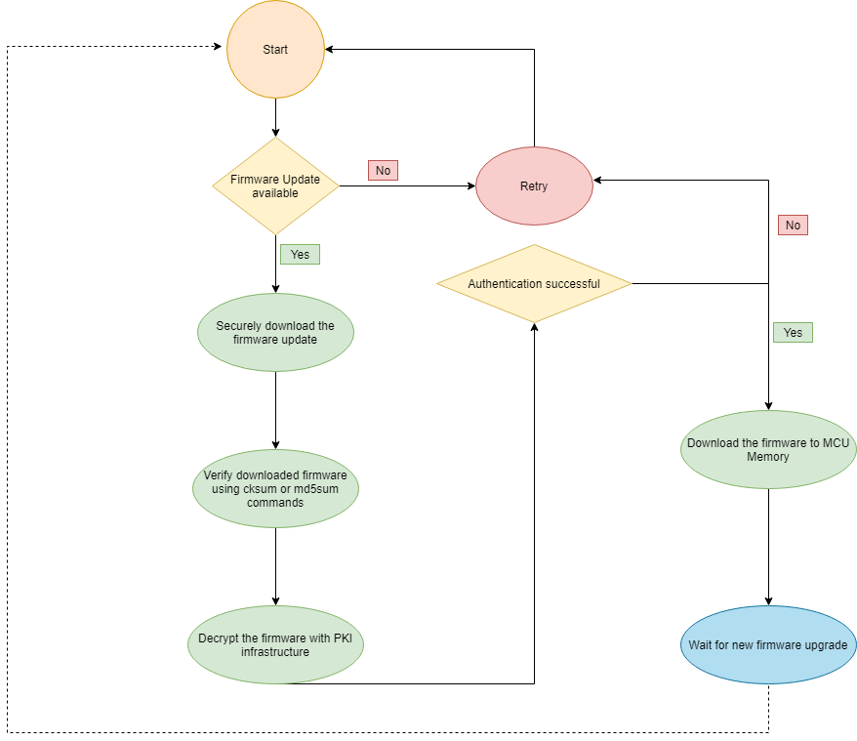
Firmware Upgrade Process

Slide 19
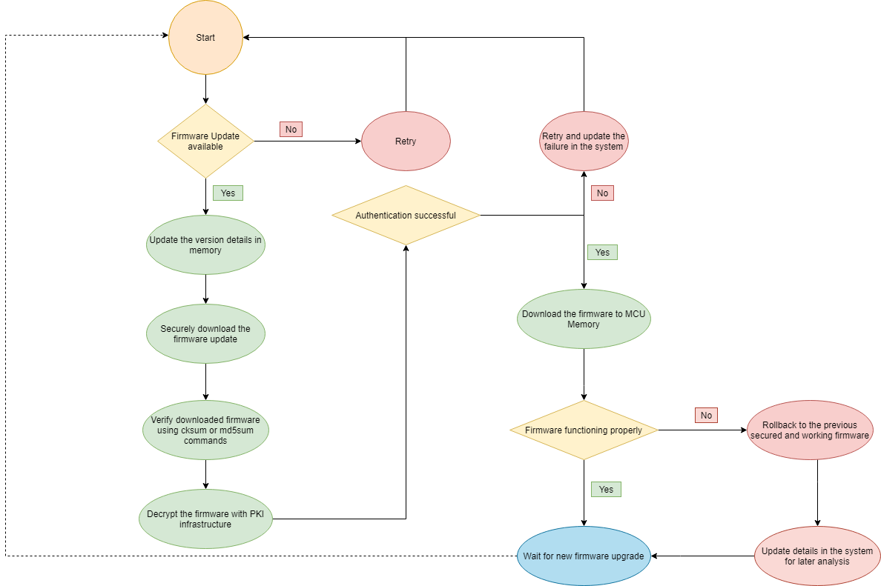
Rollback Protection

Slide 20
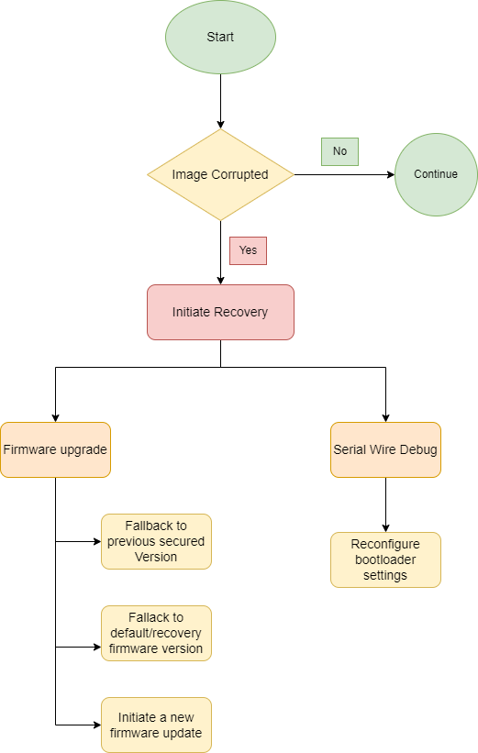
Bootloader Recovery

Slide 21
Threat Models and Best Practices
Threats:
Unauthorized Code Execution
Insider Threats
Firmware-level Attacks
Supply Chain Attacks
Tampering and Reverse Engineering
Rollback Attacks
Preventive Measures:
Understand the Requirements
Design a Secure Boot Architecture
Implement Secure Firmware Transfer
Establish a Secure Update Mechanism
Perform Firmware Verification and Authentication
Employ Robust Error Handling
Regularly Update Bootloader and Firmware
Test and Validate the Integration

Slide 22
Limitations and Challenges
Resource Constraints
Compatibility and Portability
Key Management and Security
Firmware Update Process
Testing and Validation
Industry Standards and Compliance

Slide 23
Future Developments
Hardware Security
Advanced Cryptographic Algorithms
Machine Learning and Artificial Intelligence
Secure Over-the-Air Updates
Privacy and Data Protection
Continuous Monitoring and Response
Security by Design

Slide 24


Slide 25
Thank You

